Slide 1
Attrition Analysis
CS-543: Machine Learning
Surya Prakash Madichetti

Slide 2
Contents of this template
You can delete this slide when you’re done editing the presentation
Fonts | To view this template correctly in PowerPoint, download and install the fonts we used
Used and alternative resources | An assortment of graphic resources that are suitable for use in this presentation
Thanks slide | You must keep it so that proper credits for our design are given
Colors | All the colors used in this presentation
Icons and infographic resources | These can be used in the template, and their size and color can be edited
Editable presentation theme | You can edit the master slides easily. For more info, click here
For more info: SLIDESGO | BLOG | FAQs
You can visit our sister projects: FREEPIK | FLATICON | STORYSET | WEPIK | VIDEVO

Slide 3
Table of contents
01
02
03
04
05
06
Introduction
EDA
Methods
Results
Results Plot
Future Work

Slide 4
Whoa!
This can be the part of the presentation where you introduce yourself, write your email…

Slide 5
01
Introduction

Slide 6
Problem Statement

Slide 7
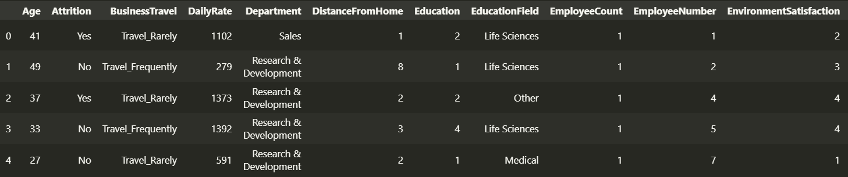
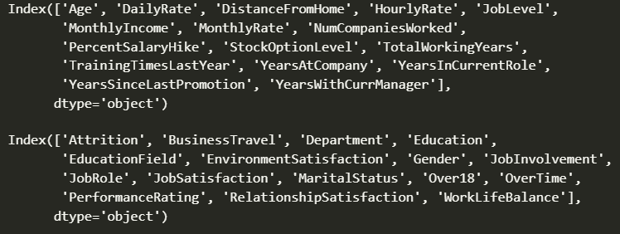
Head of Data

Slide 8
02
EDA

Slide 9
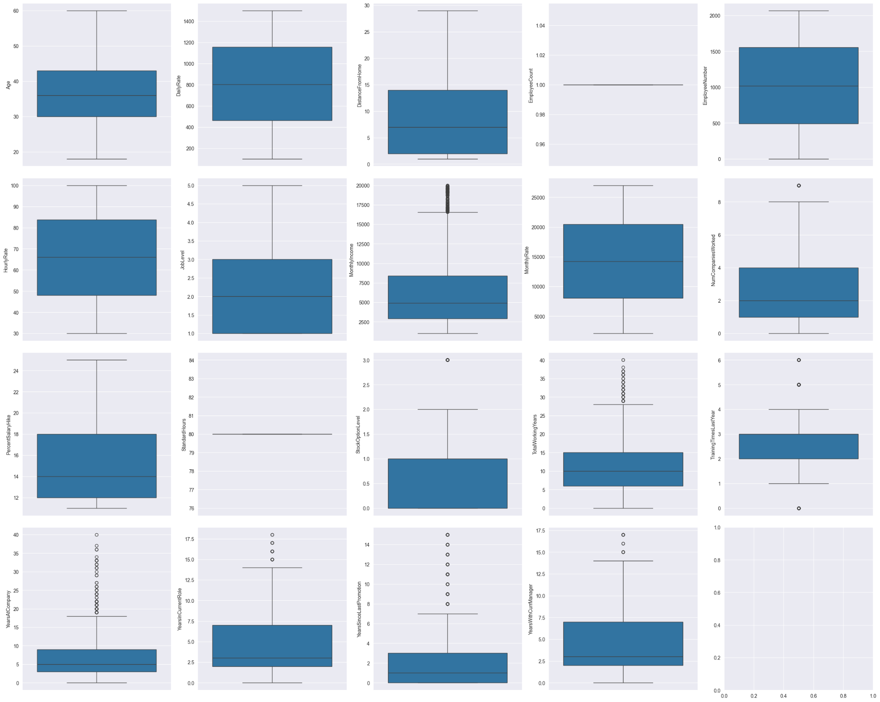

Slide 10
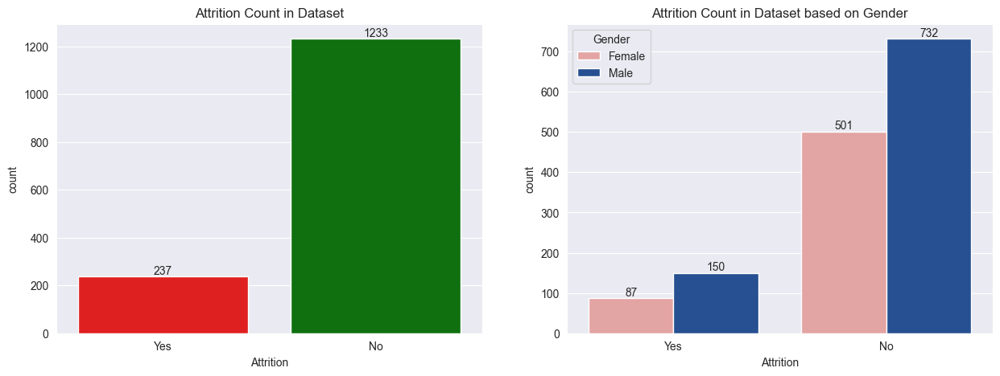
Attrition based on Gender

Slide 11
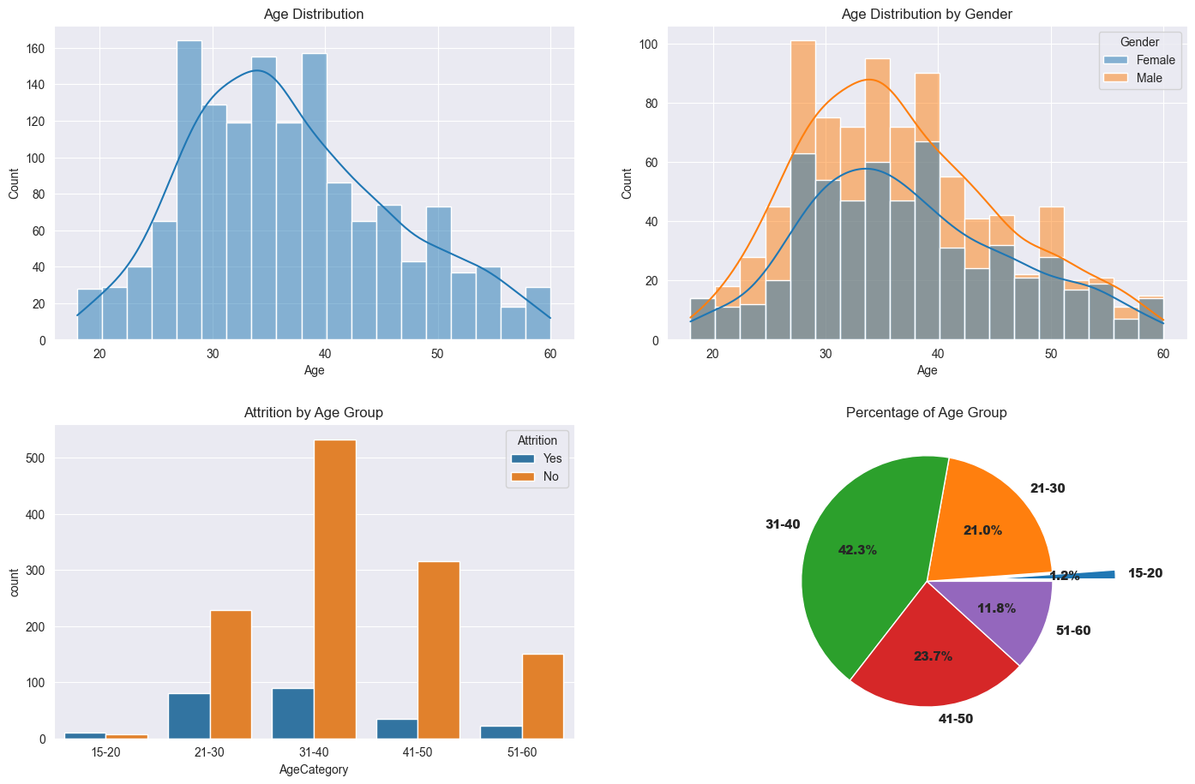
Attrition based on Age

Slide 12
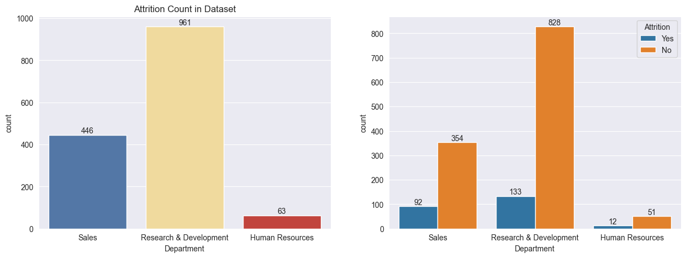
Attrition based on Department

Slide 13
03
Methods

Slide 14
Methods Used
Feature Selection
Train/Test split
Feature Transformation
Randomized Search

Slide 15
04
Results

Slide 16
Models and Results
Models
Accuracy
1st: ~77%
2nd: ~85%
Decision Tree Classifier
1st: ~87%
2nd: ~86%
Random Forest Classifier
1st: ~84%
2nd: ~82%
Neural Network Classifier

Slide 17
05
Results Plot

Slide 18
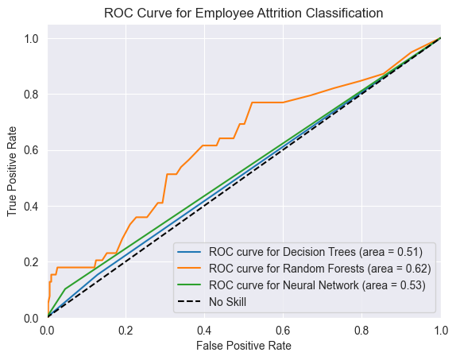
1st: Without Tuning

Slide 19
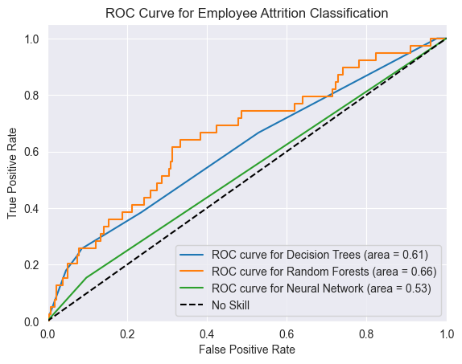
2nd: With Tuning

Slide 20
06
Future Work

Slide 21
Thanks!
Do you have any questions?
Please keep this slide for attribution

